Slide 1
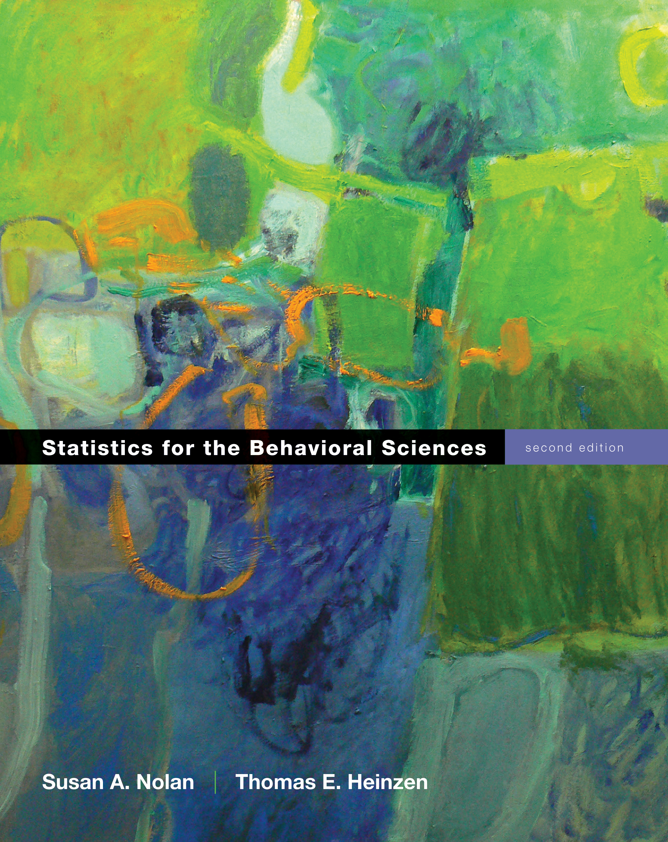
Correlation
Chapter 15

Slide 2
A research design reminder
Experimental designs
You directly manipulated the independent variable.
Quasi-experimental designs
You examined naturally occurring groups.
Correlational designs
You just observed the independent variable.

Slide 3
Defining Correlation
Co-variation or co-relation between two variables
These variables change together
Usually scale (interval or ratio) variables
Correlation does NOT mean causation!

Slide 4
Correlation versus Correlation
Correlational designs = research that doesn’t manipulate things because you can’t ethically or don’t want to.
You can use all kinds of statistics on these depending on what you types of variables you have.
Correlation the statistic can be used in any design type with two continuous variables.

Slide 5
Correlation Coefficient
A statistic that quantifies a relation between two variables
Tells you two pieces of information:
Direction
Magnitude

Slide 6
Correlation Coefficient
Direction
Can be either positive or negative
Positive: as one variable goes up, the other variable goes up
Negative: as one variable goes up, the other variable goes down.

Slide 7
Positive Correlation
Association between variables such that high scores on one variable tend to have high scores on the other variable
A direct relation between the variables

Slide 8
Negative Correlation
Association between variables such that high scores on one variable tend to have low scores on the other variable
An inverse relation between the variables

Slide 9
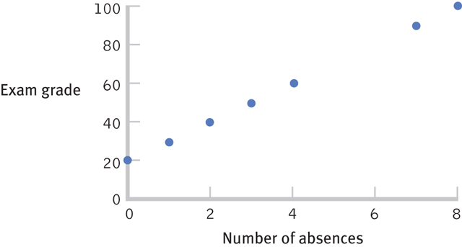
A Perfect Positive Correlation

Slide 10
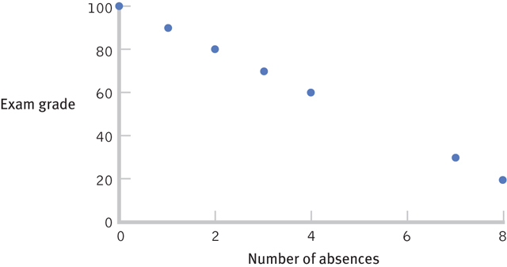
A Perfect Negative Correlation

Slide 11
Correlation Coefficient
Magnitude
Falls between -1.00 and 1.00
The value of the number (not the sign) indicates the strength of the relation

Slide 12
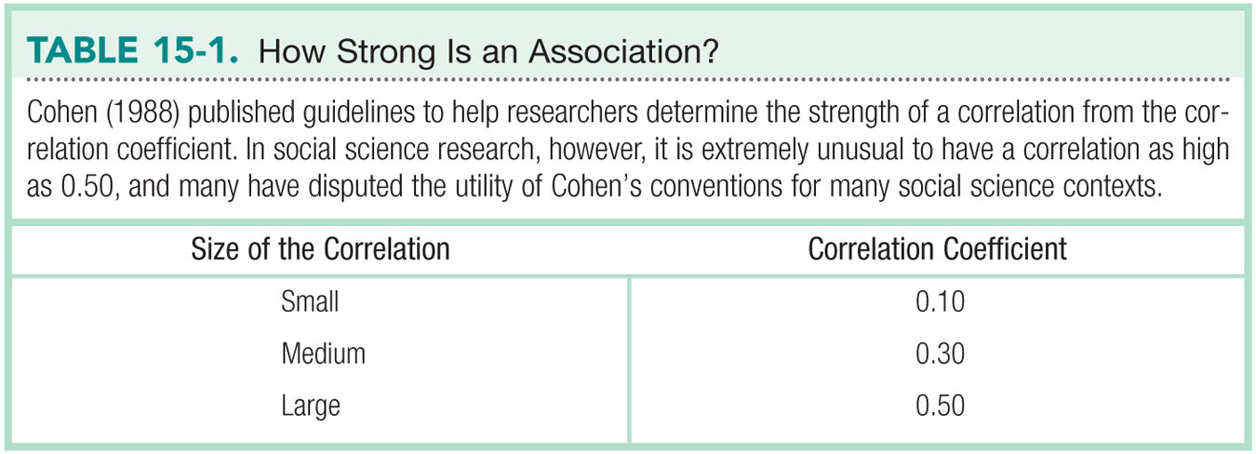

Slide 13
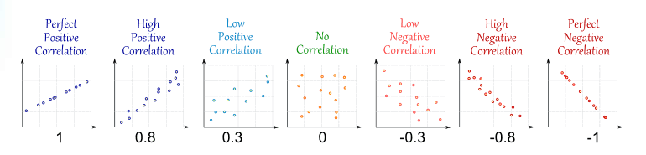
A visual guide

Slide 14
Check Your Learning
Which is stronger?
A correlation of 0.25 or -0.74?

Slide 15
Misleading Correlations
Something to think about
There is a 0.91 correlation between ice cream consumption and drowning deaths.
Does eating ice cream cause drowning?
Does grief cause us to eat more ice cream?

Slide 16
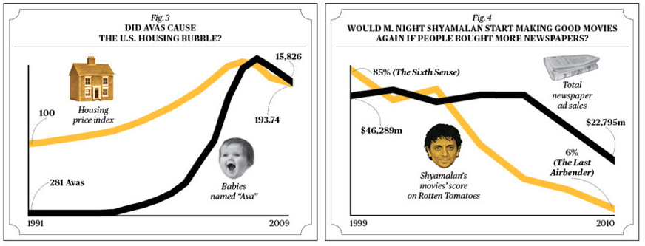
Another silly example

Slide 17
Correlation Overall
Tells us that two variables are related
How they are related (positive, negative)
Strength of relationship (closer to | 1 | is stronger).
Lots of things can be correlated – must think about what that means.

Slide 18
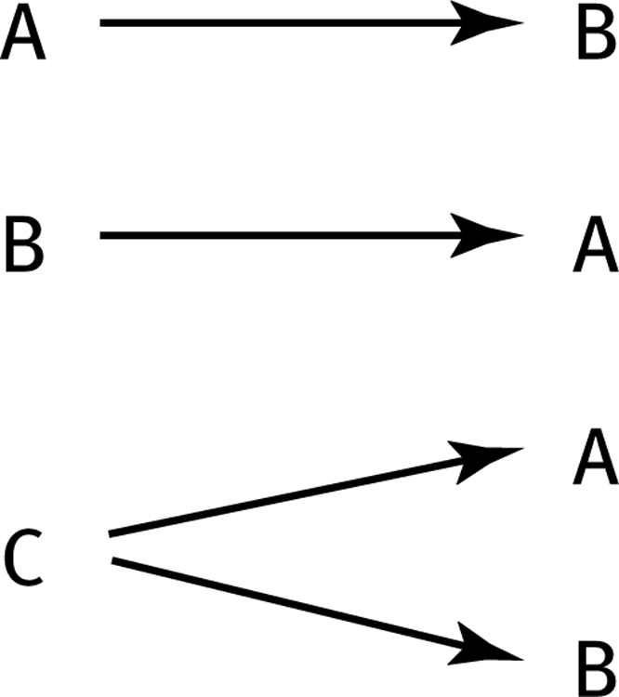
The Limitations of Correlation
Correlation is not causation.
Invisible third variables
Three Possible Causal Explanations for a Correlation

Slide 19
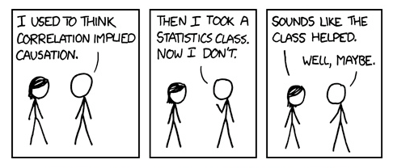
Causation Direction

Slide 20
The Limitations of Correlation, cont.
Restricted Range.
A sample of boys and girls who performed in the top 2% to 3% on standardized tests - a much smaller range than the full population from which the researchers could have drawn their sample.

Slide 21
Restricted Range, cont.
If we only look at the older students between the ages of 22 and 25, the strength of this correlation is now far smaller, just 0.05.

Slide 22
The Limitations of Correlation, cont.
The effect of an outlier.
One individual who both studies and uses her cell phone more than any other individual in the sample changed the correlation from 0.14, a negative correlation, to 0.39, a much stronger and positive correlation!

Slide 23
The Pearson Correlation Coefficient
A statistic that quantifies a linear relation between two scale variables.
Symbolized by the italic letter r when it is a statistic based on sample data.
Symbolized by the italic letter p “rho” when it is a population parameter.

Slide 24
Pearson correlation coefficient
r
Linear relationship

Slide 25
Correlation Hypothesis Testing
Step 1. Identify the population, distribution, and assumptions
Step 2. State the null and research hypotheses.
Step 3. Determine the characteristics of the comparison distribution.
Step 4. Determine the critical values.
Step 5. Calculate the test statistic
Step 6. Make a decision.

Slide 26
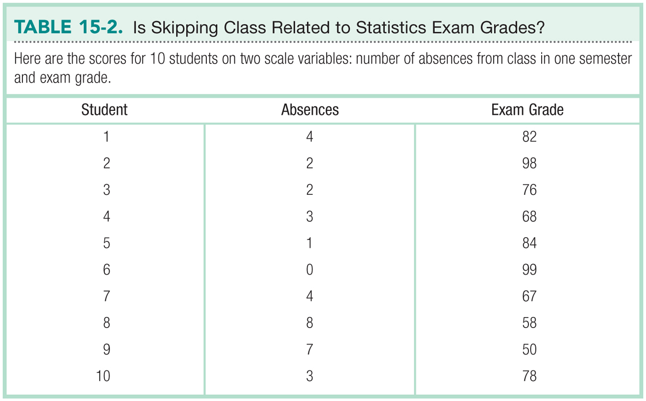

Slide 27
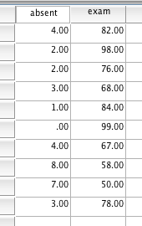
SPSS
Since I have two scores from each person, be sure to line them up side by side.

Slide 28
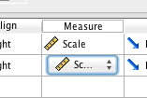
SPSS
Under variable view, be sure both are listed as scale – otherwise you won’t be able to create the right type of graph.

Slide 29
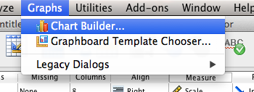
SPSS
Graph > Chart Builder

Slide 30
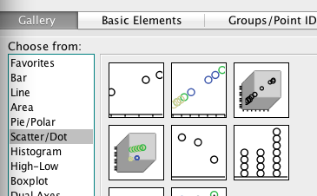
SPSS
Click on scatter/dot, and drag/drop the first box into the graph building area.

Slide 31
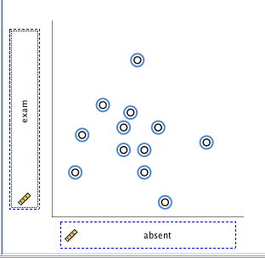
SPSS
Drag one variable into X, one variable into Y.
Remember, this view is NOT the real scatterplot.

Slide 32
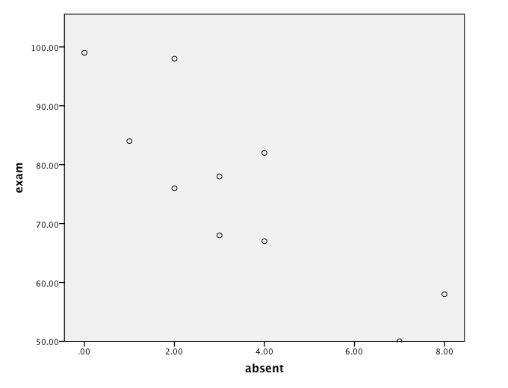
SPSS
Hit ok!

Slide 33
SPSS
Starting with a scatterplot helps you to see what the direction (negative) and magnitude (strong) should be for the correlation.
Remember that N has a large influence on power for rejecting the null, so even strong correlations can be nonsignificant.

Slide 34
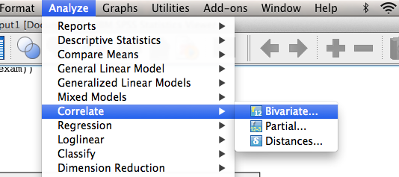
SPSS
To get the correlation coeffiecient, r:
Analyze > correlate > bivariate

Slide 35
SPSS
Move both variables over to the right, hit ok.

Slide 36
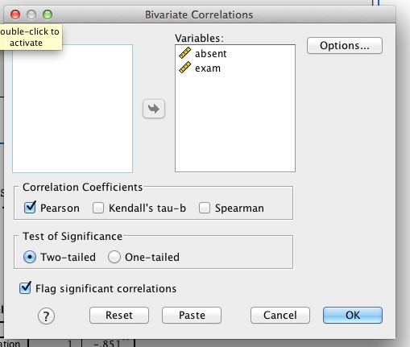
SPSS

Slide 37
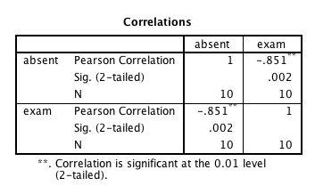
SPSS Output

Slide 38
Assumptions
Random selection
X and Y are at least scale variables
X and Y are both normal
Homoscedasticity (for real this time!)
Each variable must vary approximately the same at each point of the other variable.
See scatterplot for UFOs, megaphones, snakes eating dinner.

Slide 39
Hypothesis Steps
Step 1:
Population: no correlation between (var 1) and (var 2)
Sample: correlation between (var 1) and (var 2)

Slide 40
Hypothesis Steps
Step 2 (with our example):
Null: r for exam grades and absences = 0
Research: r for exam grades and absences /= 0
(can also use the rho symbol).

Slide 41
Hypothesis Steps
Step 3:
List r = -.851
List df = N – 2 *** = 8
*** whoa! It’s N – 1(for X) – 1(for Y).

Slide 42
Hypothesis Steps
Step 4:
(note: different from your book)
Find the t-cut off score from a t-table given your df.
p < .05 = + / - 2.306

Slide 43
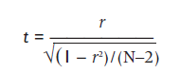
Hypothesis Steps
Step 5:
Calculate the t-found given your r value.

Slide 44
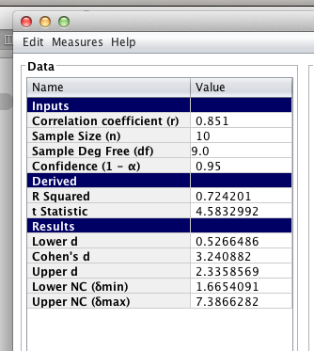
Or you can use MOTE! ☺

Slide 45
Effect Size?
r is often considered an effect size.
Most people square it though to r², which is the same as ANOVA effect size.
You can also switch r to Cohen’s d, but people are moving away from doing this because d normally is reserved for nominal variables.

Slide 46
Confidence Intervals
Involves Fisher’s r to z transform and is generally pretty yucky.
Which means people do not do them unless they are required to.

Slide 47
Correlation and Psychometrics
Psychometrics is used in the development of tests and measures.
Psychometricians use correlation to examine two important aspects of the development of measures—reliability and validity.

Slide 48

Reliability
A reliable measure is one that is consistent.
Example types of reliability:
Test–retest reliability.
Split-half reliability
Cronbach’s alpa (aka coefficient alpha)
Want to be bigger than .80.

Slide 49
Validity
A valid measure is one that measures what it was designed or intended to measure.
Correlation is used to calculate validity, often by correlating a new measure with existing measures known to assess the variable of interest.

Slide 50

Correlation can also be used to establish the validity of a personality test.
Establishing validity is usually much more difficult than establishing reliability.
Buzzfeed!

Slide 51
Partial Correlation
A technique that quantifies the degree of association between two variables after statistically removing the association of a third variable with both of those two variables.
Allows us to quantify the relation between two variables, controlling for the correlation of each of these variables with a third related variable.

Slide 52
We can assess the correlation between number of absences and exam grade, over and above the correlation of percentage of completed homework assignments with these variables.

